Slide 1
INFORMATION THEORY
Week 5
Optimal coding
IITU, ALMATY, 2019
Notes:
IITU, Almaty, Fall 2012
SEPTEMBER 5, 2012
By Assem Zhamankulova, MSCS

Slide 2
Encoding and Decoding
Convert the message into a signal suitable for transmission over the channel of communication, referred to as coding in a broad sense.
The operation of recovering messages to the received signal is called decoding.

Slide 3
Conditions of the analyzing of information systems
Source of the message selects message from the set with a certain probability.
Messages can be sent via communication canal as a code. Coded messages form a set, which is a one-one mapping of the set of source messages. Decoder knows decoding rule (written in his program).
Messages follow each other, and the number of messages can be arbitrarily large.

Slide 4
Conditions of the analyzing of information systems
Message is received correctly, if after decoding it can be exactly restored. This does not take into account how much time has passed since receiving to the end of the decoding, and the complexity of the encoding and decoding processes.
The amount of information is independent of the semantic content of the message, from its emotional impact, usefulness and even its relationship to reality.

Slide 5
Types of coding
Uniform coding
Letters have code combinations (code words) with the same lengths
Non-uniform coding – optimal (efficient) coding
Letters have code combinations (code words) with different lengths depending on probabilities

Slide 6
Optimal (efficient) coding
An alphabet has letters a1, a2, a3…an with some probabilities of occurrence p1, p2, p3…pn.
Then
pi > pj and li<=lj,
where li,lj – length of a letters’ code

Slide 7
Examples of optimal coding
Shannon-Fano algorithm
Huffman algorithm

Slide 8
Example of non-uniform coding:
Shannon-Fano algorithm
An alphabet has 4 letters A, B, C and d and their probabilities are p(a)=1/2, p(b)=1/4, p(c)=1/8, p(c)=1/8.
Construct Shannon-Fano code for this alphabet.

Slide 9
Shannon-Fano algorithm: step 1
Characters (or any message to be encoded) of the original alphabet are setted in descending order of probability.
Letter | Probability
A | 1/2
B | 1/4
C | 1/8
D | 1/8

Slide 10
Shannon-Fano algorithm: step 2
Ordered letters divided to the two subsets so that the overall probability of these subsets were about equal.
For example, p(a) = p(b)+p(c)+p(d)
Letter | Probability
A | 1/2
B | 1/4
C | 1/8
D | 1/8

Slide 11
Shannon-Fano algorithm: step 3
For all characters (letters) of the top subset assign a code element 1, and for characters of the lower subset the 0 code.
Letter | Probability | Code
A | 1/2 | 1
B | 1/4 | 0
C | 1/8 | 0
D | 1/8 | 0

Slide 12
Shannon-Fano algorithm: step 4
Then each subset again divided into two subsets with the same condition that the sum of probabilities of subsets approximately are the same and with the same condition of assignment codes.
Letter | Probability | Code
A | 1/2 | 1
B | 1/4 | 01
C | 1/8 | 00
D | 1/8 | 00

Slide 13
Shannon-Fano algorithm: step 5
Such a partition can be continued to as long as in the subset will be one character.
Letter | Probability | Code
A | 1/2 | 1
B | 1/4 | 01
C | 1/8 | 001
D | 1/8 | 000

Slide 14
Shannon-Fano algorithm
Characters (or any message to be encoded) of the original alphabet are setted in descending order of probability.
Ordered letters divided to the two subsets so that the overall probability of these subsets were about equal.
For all characters (letters) of the top subset assign a code element 1, and for characters of the lower subset the 0 code.
Then each subset again divided into two subsets with the same condition that the sum of probabilities of subsets approximately are the same and with the same condition of assignment codes.
Such a partition can be continued to as long as in the subset will be one character.

Slide 15


Is the code optimal?
If qavr = H then the code is optimal
Letter | Probability | Code | Length qi | piqi | -pilogpi
A | 1/2 | 1 | 1 | 0.5 | 0.5
B | 1/4 | 01 | 2 | 0.5 | 0.5
C | 1/8 | 001 | 3 | 0.375 | 0.375
D | 1/8 | 000 | 3 | 0.375 | 0.375

Slide 16
Removal of redundancy by coding blocks of characters
Consider a procedure of efficient coding, Shannon-Fano message formed from alphabet, consisting of two characters x1 and x2, with the probabilities of occurrence P (x1) = 0,9 and P (x2) = 0,1 respectively.

Slide 17
Coding by blocks
Possible combinations:
x1x1, x1x2, x2x1, x2x2
Block | Probability | Code
x1x1 | 0.81 | 1
x1x2 | 0.09 | 01
x2x1 | 0.09 | 001
x2x2 | 0.01 | 000

Slide 18
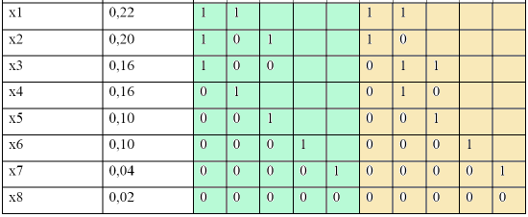
Different codes of the same source

Slide 19
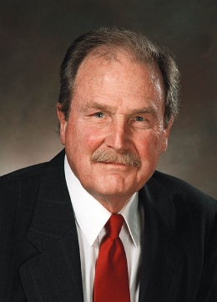
Huffman code: History
In 1951, David A. Huffman and his MIT Information Theory classmates were given the choice of a term paper or a final exam. The professor, Robert M. Fano, assigned a term paper on the problem of finding the most efficient binary code. Huffman, unable to prove any codes were the most efficient, was about to give up and start studying for the final when he hit upon the idea of using a frequency-sorted binary tree and quickly proved this method the most efficient.
In doing so, the student outdid his professor, who had worked with Information Theory inventor Claude Shannon to develop a similar code.
A Huffman code is an optimal code found using the algorithm developed by David A. Huffman while he was a Ph.D. student at MIT, and published in the 1952 paper "A Method for the Construction of Minimum-Redundancy Codes".

Slide 20
Huffman algorithm
Characters (or any message to be encoded) of the original alphabet are setted in descending order of probability (as for Shannon-Fano algorithm).
Work in a table
Construct a tree
Reading codewords

Slide 21
Huffman algorithm: Example
An alphabet has 4 letters A, B, C and D and their probabilities are p(A)=1/2, p(B)=1/4, p(C)=1/8, p(D)=1/8.
Construct Huffman code for this alphabet.

Slide 22
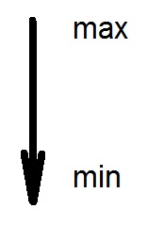
Huffman algorithm: step 1
Characters (or any message to be encoded) of the original alphabet are setted in descending order of probability.
Letter | Probability
A | 1/2
B | 1/4
C | 1/8
D | 1/8

Slide 23
Huffman algorithm: step 2
Sum the two minimum probabilities.
Characters of the original alphabet are setted again in descending order of new probabilities.
Letter | Probability | Iteration1
A | ½ | ½
B | ¼ | ¼
C | 1/8 | 1/8+1/8=1/4 (C+D)
D | 1/8

Slide 24
Huffman algorithm: step 3
Repeat the step 2 again and again until there is only 1 symbol with probability = 1.
Letter | Probability | Iteration1 | Iteration 2
A | ½ | ½ | ½
B | ¼ | ¼ | ¼+¼= ½ (B+C+D)
C | 1/8 | ¼ (C+D)
D | 1/8

Slide 25
Huffman algorithm: step 3
Repeat the step 2 again and again until there is only 1 group of symbols with probability = 1.
Letter | Probability | Iteration 1 | Iteration 2 | Iteration 3
A | ½ | ½ | ½ | 1 (A+B+C+D)
B | ¼ | ¼ | ½ (B+C+D)
C | 1/8 | ¼ (C+D)
D | 1/8

Slide 26
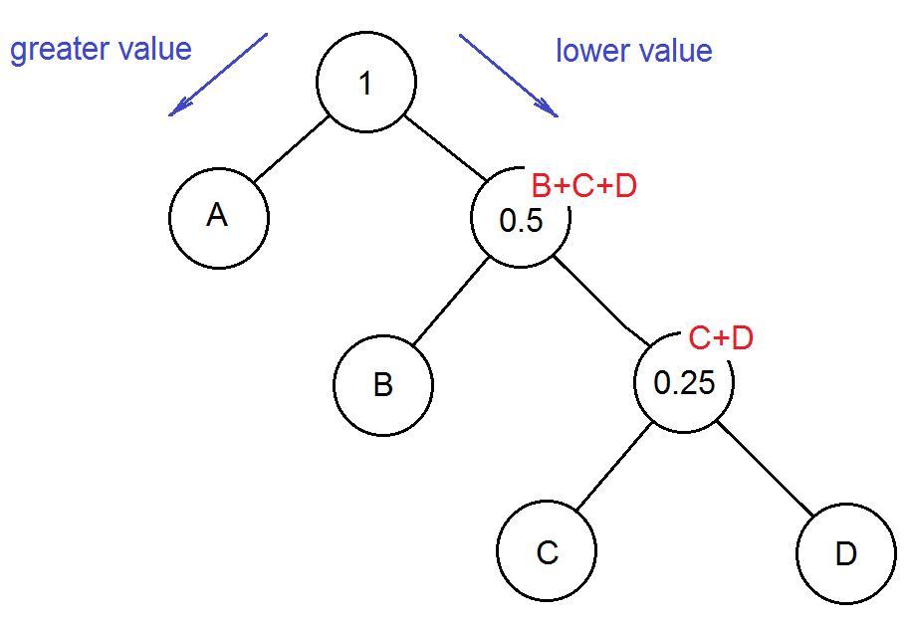
Step 4: Huffman’s tree

Slide 27
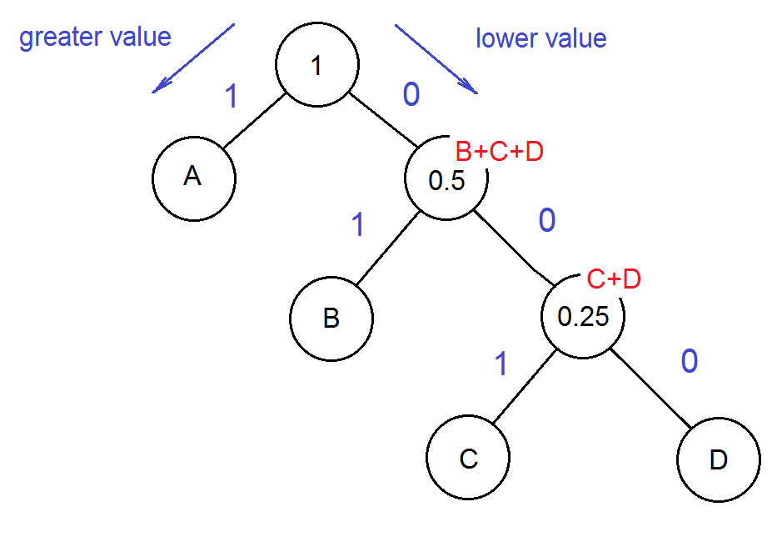
Step 5: weight or bits

Slide 28
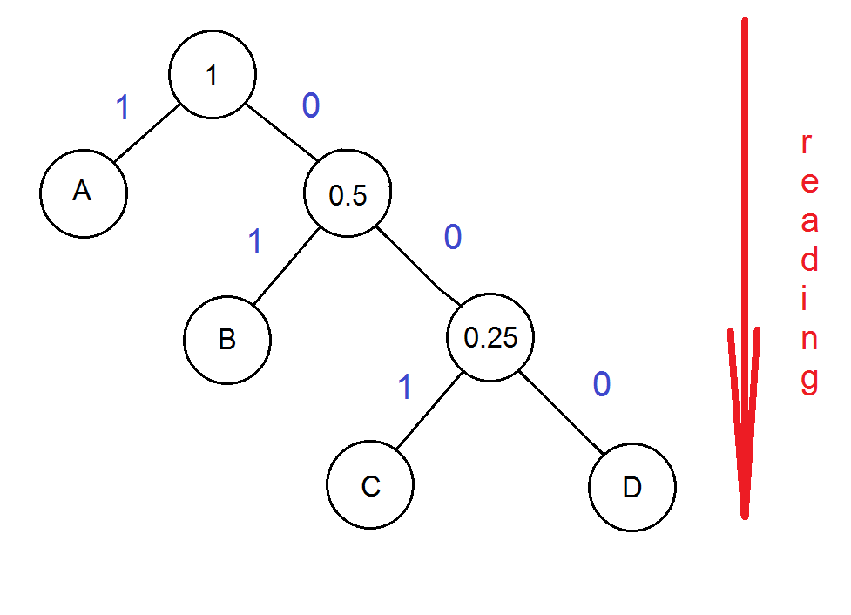
Step 6: codewords
Letter | Probability | Codeword
A | ½ | 1
B | ¼ | 01
C | 1/8 | 001
D | 1/8 | 000

Slide 29
Prefix codes
Prefix codes (sometimes called "prefix-free codes“) is a type of code system (typically a variable-length code) distinguished by its possession of the "prefix property", which requires that there is no codeword in the system that is a prefix (initial segment) of any other code word in the system.
A prefix code is a uniquely decodable code: a receiver can identify each word without requiring a special marker between words.

Slide 30
Prefix and non-prefix codes
Are the next codes prefix?
1, 01, 101, 000
1, 01, 001, 000
1, 11, 001, 000
11, 101, 100, 01, 001, 0001, 00001, 00000

Slide 31
Lab works 5 & 6
Construct a Shannon-Fano code (lab work 5) and a Huffman code (lab work 6) for your last name.
Define if the results of coding are optimal (for a Shannon-Fano code and for a Huffman code)?

